Slide 1
Session 6 – Java Bean and MVC

Slide 2
Including Files & Applets in JSP Documents
Including the output of JSP, HTML or plain text pages at the time the client requests the page
Including JSP files at the time the main page is translated into a servlet
Including applets that use the Java Plug-In

Slide 3
Including Files at Request Time
Format
  <jsp:include page="Relative URL" flush="true" />
Purpose
  To reuse JSP, HTML, or plain text content
  JSP content cannot affect main page:
  only output of included JSP page is used
  To permit updates to the included content without changing the main JSP page(s)
Notes
  You are not permitted to specify false for
  the flush attribute in JSP 1.1 and earlier
  Don't forget that trailing slash

Slide 4
Including Files: Example Code
...
<BODY>
<CENTER>
<TABLE BORDER=5>
<TR><TH CLASS="TITLE">
What's New at JspNews.com</TABLE>
</CENTER>
<P>
Here is a summary of our four most recent news stories:
<OL>
<LI><jsp:include page="news/Item1.html" flush="true" />
<LI><jsp:include page="news/Item2.html" flush="true" />
<LI><jsp:include page="news/Item3.html" flush="true" />
<LI><jsp:include page="news/Item4.html" flush="true" />
</OL>
</BODY></HTML>

Slide 5
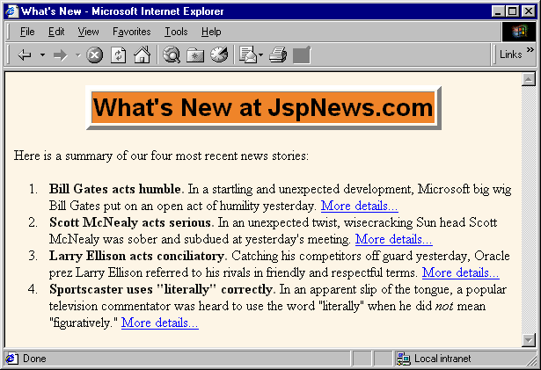
Including Files: Example Result

Slide 6
Including Files at Page Translation Time
Format
  <%@ include file="Relative URL" %>
Purpose
  To reuse JSP content in multiple pages, where JSP content affects main page
Notes
  Servers are not required to detect changes to the included file, and in practice they don't.
  Thus, you need to change the JSP files whenever the included file changes.
  You can use OS-specific mechanisms such as the Unix "touch" command, or
    <%-- Navbar.jsp modified 3/1/00 --%>
    <%@ include file="Navbar.jsp" %>

Slide 7
Differences Between jsp:include and @include
jsp:include includes the output of the designated page
  @include includes the actual code
jsp:include occurs at request time
  @include occurs at page translation time
With jsp:include, the main page and the included page become two separate servlets
  With @include, they become parts of a single servlet
jsp:include automatically handles changes to the included file
  @include might not (big maintenance problem!)
Notes:
That means whenever you change your included file, you have to request to recompile the main page file.

Slide 8
Reusable JSP Content: ContactSection.jsp
<%@ page import="java.util.Date" %>
<%-- The following become fields in each servlet that
results from a JSP page that includes this file. --%>
<%!
private int accessCount = 0;
private Date accessDate = new Date();
private String accessHost = "<I>No previous access</I>";
%>
<P>
<HR>
This page &copy; 2000
<A HREF="http//www.my-company.com/">my-company.com</A>.
This page has been accessed <%= ++accessCount %>
times since server reboot. It was last accessed from
<%= accessHost %> at <%= accessDate %>.
<% accessHost = request.getRemoteHost(); %>
<% accessDate = new Date(); %>

Slide 9
Using the JSP Content
...
<BODY>
<TABLE BORDER=5 ALIGN="CENTER">
<TR><TH CLASS="TITLE">
Some Random Page</TABLE>
<P>
Information about our products and services.
<P>
Blah, blah, blah.
<P>
Yadda, yadda, yadda.
<%@ include file="ContactSection.jsp" %>
</BODY>
</HTML>

Slide 10
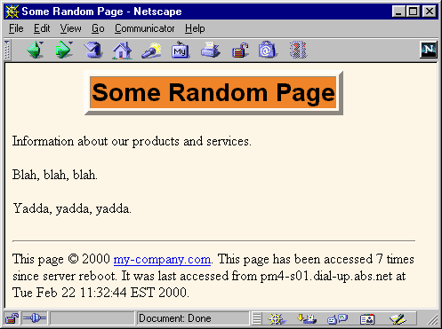
Using the JSP Content: Result

Slide 11
Including Applets for the Java Plug-In
Neither Netscape 4 nor IE 5/6 support Java 2
  Netscape 6 supports JDK 1.3
Problems using applets
  In order to use Swing, you must send the Swing files over the network. This process is time consuming and fails in Internet Explorer 3 and Netscape 3.x and 4.01-4.05 (which only support JDK 1.02).
  You cannot use Java 2D
  You cannot use the Java 2 collections package
  Your code runs more slowly, since most compilers for the Java 2 platform are significantly improved over their 1.1 predecessors

Slide 12
Solution (?)
Use the Java Plug-In
Only a viable option for intranets
  Requires each client to install large browser plug-in
Cannot use simple APPLET tag
Need long and ugly OBJECT tag for
Internet Explorer
Need long and ugly EMBED tag for
Netscape
The jsp:plugin action lets you write a simple tag that gets translated into the OBJECT and EMBED tags that are required
  Warning: jsp:plugin fails in JRun 3 SP2
Notes:
It is also fail in Mozilla with JRE version 1.6_03

Slide 13
Using jsp:plugin
APPLET Tag
  <APPLET CODE="MyApplet.class"
  WIDTH=475 HEIGHT=350>
  </APPLET>
Equivalent jsp:plugin
  <jsp:plugin type="applet"
  code="MyApplet.class"
  width="475" height="350">
  </jsp:plugin>
Reminder
  JSP element and attribute names are case sensitive
  All attribute values must be in single or double quotes
  This is like XML but unlike HTML
Notes:
Use example from Webapplication1 project.

Slide 14
Attributes of the jsp:plugin Element
type
  For applets, this should be "applet".
  Use "bean" to embed JavaBeans elements in Web pages.
code
  Used identically to CODE attribute of APPLET, specifying the top-level applet class file
width, height
  Used identically to WIDTH, HEIGHT in APPLET
codebase
  Used identically to CODEBASE attribute of APPLET
align
  Used identically to ALIGN in APPLET and IMG

Slide 15
Attributes of the jsp:plugin Element (Cont.)
hspace, vspace
  Used identically to HSPACE, VSPACE in APPLET,
archive
  Used identically to ARCHIVE attribute of APPLET, specifying a JAR file from which classes and images should be loaded
name
  Used identically to NAME attribute of APPLET, specifying a name to use for inter-applet communication or for identifying applet to scripting languages like JavaScript.
title
  Used identically to rarely used TITLE attribute

Slide 16
Attributes of the jsp:plugin Element (Cont.)
jreversion
  Identifies version of the Java Runtime Environment (JRE) that is required. Default is 1.1.
iepluginurl
  Designates a URL from which plug-in for Internet Explorer can be downloaded. Users who don’t already have the plug-in installed will be prompted to download it from this location. Default value will direct user to Sun site, but for intranet use you might want to direct user to a local copy.
nspluginurl
  Designates a URL from which plug-in for Netscape can be downloaded. Default value will direct user to Sun site, but for intranet use you might want local copy.

Slide 17
The jsp:param and jsp:params Elements
PARAM Tags
  <APPLET CODE="MyApplet.class"
  WIDTH=475 HEIGHT=350>
  <PARAM NAME="PARAM1" VALUE="VALUE1">
  <PARAM NAME="PARAM2" VALUE="VALUE2">
  </APPLET>
Equivalent jsp:param
  <jsp:plugin type="applet"
  code="MyApplet.class"
  width="475" height="350">
  <jsp:params>
  <jsp:param name="PARAM1" value="VALUE1" />
  <jsp:param name="PARAM2" value="VALUE2" />
  </jsp:params>
  </jsp:plugin>

Slide 18
The jsp:fallback Element
APPLET Tag
  <APPLET CODE="MyApplet.class"
  WIDTH=475 HEIGHT=350>
  <B>Error: this example requires Java.</B>
  </APPLET>
Equivalent jsp:plugin with jsp:fallback
  <jsp:plugin type="applet"
  code="MyApplet.class"
  width="475" height="350">
  <jsp:fallback>
  <B>Error: this example requires Java.</B>
  </jsp:fallback>
  </jsp:plugin>

Slide 19
Example Using Plugin
<DOCTYPE ...>...
<jsp:plugin
type="applet"
code="coreservlets.ShadowedTextApplet.class"
width="475" height="350">
<jsp:params>
<jsp:param name="MESSAGE"
value="Your Message Here" />
</jsp:params>
</jsp:plugin>
...
</BODY></HTML>
See book and Web site for applet code

Slide 20
Example Using Plugin: Resultant HTML
<DOCTYPE ...>...
<OBJECT
classid=clsid:8AD9C840-044E-11D1-B3E9-00805F499D93
width="370" height="420"
codebase="http://java.sun.com/products/plugin/1.2.2/jinstall-1_2_2-win.cab#Version=1,2,2,0">
<PARAM name="java_code" value="PluginApplet.class">
<PARAM name="type" value="application/x-java-applet;">
<COMMENT>
<EMBED type="application/x-java-applet;"
width="370" height="420"
pluginspage="http://java.sun.com/products/plugin/"
>
<NOEMBED>
</COMMENT>
</NOEMBED></EMBED>
</OBJECT>
...
</BODY></HTML>

Slide 21
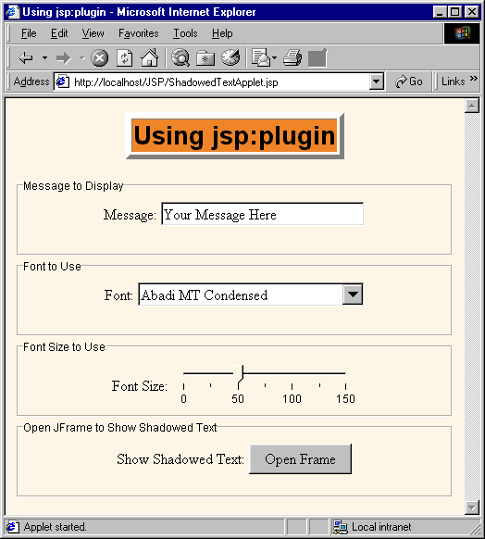
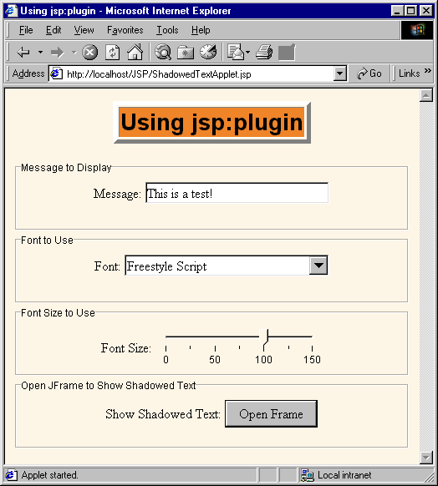
Example Using Plugin (Continued)

Slide 22
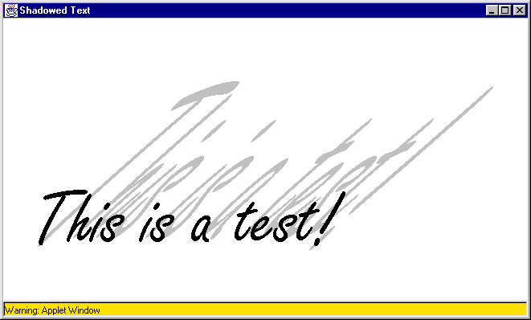
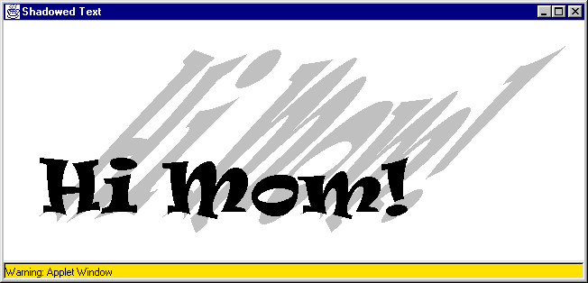
Example Using Plugin (Continued)

Slide 23
Summary
<jsp:include page="Relative URL"
flush="true" />
  Output of URL inserted into JSP page at request time
  Cannot contain JSP content that affects entire page
  Changes to included file do not necessitate changes to pages that use it
<%@ include file="Relative URL" %>
  File gets inserted into JSP page prior to page translation
  Thus, file can contain JSP content that affects entire page (e.g., import statements, declarations)
  Changes to included file require you to manually update pages that use it
<jsp:plugin ...> simplifies applets for plugin

Slide 24
Using JavaBeans with JSP
Overview of beans in Java
Basic use of beans in JSP
Creating and accessing beans
Setting bean properties explicitly
Associating individual bean properties with request parameters
Associating all bean properties with request parameters
Conditional bean operations
Sharing beans among multiple JSP pages and servlets

Slide 25
Uses of JSP Constructs
Simple
Application
Scripting elements calling servlet code directly
Scripting elements calling servlet code indirectly (by means of utility classes)
Beans
Custom tags
Servlet/JSP combo (MVC),
with beans and possibly custom tags
Complex
Application

Slide 26
Background: What Are Beans?
Java classes that follow certain conventions
  Must have a zero-argument (empty) constructor
    You can satisfy this requirement either by explicitly defining such a constructor or by omitting all constructors
  Should have no public instance variables (fields)
    I hope you already follow this practice and use accessor methods instead of allowing direct access to fields
  Persistent values should be accessed through methods called getXxx and setXxx
    If class has method getTitle that returns a String, class is said to have a String property named title
    Boolean properties use isXxx instead of getXxx
  For more on beans, see
  http://java.sun.com/beans/docs/
Notes:
Java beans are a real class follow some requirements
Purpose: share to include to many application

Slide 27
Why You Should Use Accessors, Not Public Fields
To be a bean, you cannot have public fields
So, you should replace
  public double speed;
with
  private double a;
  public double getSpeed() {
  return(a);
  }
  public void setSpeed(double newSpeed) {
  a = newSpeed;
  }
You should do this in all your Java code anyhow. Why?

Slide 28
Why You Should Use Accessors, Not Public Fields
1) You can put constraints on values
  public void setSpeed(double newSpeed) {
  if (newSpeed < 0) {
  sendErrorMessage(...);
  newSpeed = Math.abs(newSpeed);
  }
  speed = newSpeed;
  }
  If users of your class accessed the fields directly, then they would each be responsible for checking constraints.

Slide 29
Why You Should Use Accessors, Not Public Fields
2) You can change your internal representation without changing interface
  // Now using metric units (kph, not mph)
  public void setSpeed(double newSpeed) {
  setSpeedInKPH = convert(newSpeed);
  }
  public void setSpeedInKPH(double newSpeed) {
  speedInKPH = newSpeed;
  }

Slide 30
Why You Should Use Accessors, Not Public Fields
3) You can perform arbitrary side effects
  public double setSpeed(double newSpeed) {
  speed = newSpeed;
  updateSpeedometerDisplay();
  }
  If users of your class accessed the fields directly, then they would each be responsible for executing side effects. Too much work and runs huge risk of having display inconsistent from actual values.

Slide 31
Basic Bean Use in JSP
Format
  <jsp:useBean id="name" class="package.Class" />
Purpose
  Allow instantiation of Java classes without explicit Java programming (XML-compatible syntax)
Notes
  Simple interpretation: JSP action
  <jsp:useBean id="book1" class="coreservlets.Book" />
  can be thought of as equivalent to the scriptlet
  <% coreservlets.Book book1 = new coreservlets.Book(); %>
  But useBean has two additional advantages:
    It is easier to derive object values from request parameters
    It is easier to share objects among pages or servlets

Slide 32
Accessing Bean Properties
Format
  <jsp:getProperty name="name" property="property" />
Purpose
  Allow access to bean properties (i.e., calls to getXxx methods) without explicit Java programming
Notes
  <jsp:getProperty name="book1" property="title" />
  is equivalent to the following JSP expression
  <%= book1.getTitle() %>

Slide 33
Setting Bean Properties:
Simple Case
Format
  <jsp:setProperty name="name"
  property="property"
  value="value" />
Purpose
  Allow setting of bean properties (i.e., calls to setXxx methods) without explicit Java programming
Notes
  <jsp:setProperty name="book1"
  property="title"
  value="Core Servlets and JavaServer Pages" />
  is equivalent to the following scriptlet
  <% book1.setTitle("Core Servlets and JavaServer Pages"); %>

Slide 34
Example: StringBean
package coreservlets;
public class StringBean {
private String message = "No message specified";
public String getMessage() {
return(message);
}
public void setMessage(String message) {
this.message = message;
}
}
Installed in normal servlet directory
  Tomcat_install_dir\webapps\ROOT\WEB-INF\classes\coreservlets
  JRun_install_dir\servers\default\default-app\WEB-INF\classes\coreservlets
Beans (and utility) classes must always be in packages!

Slide 35
JSP Page That Uses StringBean
<jsp:useBean id="stringBean"
class="coreservlets.StringBean" />
<OL>
<LI>Initial value (getProperty):
<I><jsp:getProperty name="stringBean"
property="message" /></I>
<LI>Initial value (JSP expression):
<I><%= stringBean.getMessage() %></I>
<LI><jsp:setProperty name="stringBean"
property="message"
value="Best string bean: Fortex" />
Value after setting property with setProperty:
<I><jsp:getProperty name="stringBean"
property="message" /></I>
<LI><%stringBean.setMessage("My favorite: Kentucky Wonder");%>
Value after setting property with scriptlet:
<I><%= stringBean.getMessage() %></I>
</OL>
Notes:
You have to rebuilt whole project to compile the beans

Slide 36
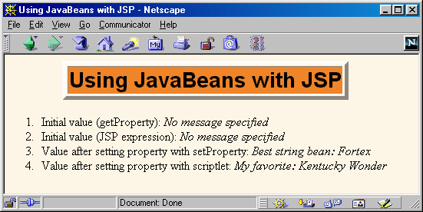
JSP Page That Uses StringBean

Slide 37
Setting Bean Properties Case 1:
Explicit Conversion & Assignment
<!DOCTYPE ...>
...
<jsp:useBean id="entry"
class="coreservlets.SaleEntry" />
<%-- setItemID expects a String --%>
<jsp:setProperty
name="entry"
property="itemID"
value='<%= request.getParameter("itemID") %>' />

Slide 38
Setting Bean Properties Case 1:
Explicit Conversion & Assignment
<%
int numItemsOrdered = 1;
try {
numItemsOrdered =
Integer.parseInt(request.getParameter("numItems"));
} catch(NumberFormatException nfe) {}
%>
<%-- setNumItems expects an int --%>
<jsp:setProperty
name="entry"
property="numItems"
value="<%= numItemsOrdered %>" />

Slide 39
Setting Bean Properties Case 1:
Explicit Conversion & Assignment
<%
double discountCode = 1.0;
try {
String discountString =
request.getParameter("discountCode");
discountCode =
Double.parseDouble(discountString);
} catch(NumberFormatException nfe) {}
%>
<%-- setDiscountCode expects a double --%>
<jsp:setProperty
name="entry"
property="discountCode"
value="<%= discountCode %>" />

Slide 40
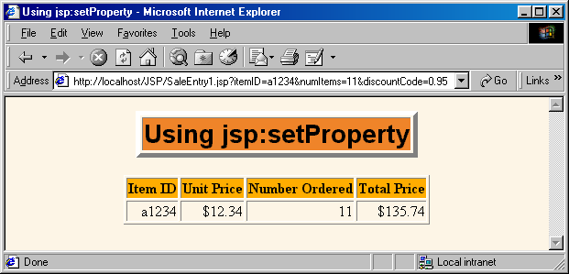
Setting Bean Properties Case 1:
Explicit Conversion & Assignment

Slide 41
Case 2: Associating Individual Properties with Input Parameters
Use the param attribute of jsp:setProperty to indicate that
  Value should come from specified request parameter
  Simple automatic type conversion should be performed for properties that expect values of standard types
    boolean, Boolean, byte, Byte, char, Character, double, Double, int, Integer, float, Float, long, or Long.

Slide 42
Case 2: Associating Individual Properties with Input Parameters
<jsp:useBean id="entry"
class="coreservlets.SaleEntry" />
<jsp:setProperty
name="entry"
property="itemID"
param="itemID" />
<jsp:setProperty
name="entry"
property="numItems"
param="numItems" />
<jsp:setProperty
name="entry"
property="discountCode"
param="discountCode" />
Notes:
Name is name of bean

Slide 43
Case 3: Associating All Properties with Input Parameters
Use "*" for the value of the property attribute of jsp:setProperty to indicate that
  Value should come from request parameter whose name matches property name
  Simple automatic type conversion should be performed

Slide 44
Case 3: Associating All Properties with Input Parameters
<jsp:useBean id="entry"
class="coreservlets.SaleEntry" />
<jsp:setProperty name="entry" property="*" />
This is extremely convenient for making "form beans" -- objects whose properties are filled in from a form submission.
  You can even divide the process up across multiple forms, where each submission fills in part of the object.

Slide 45
Sharing Beans
You can use scope attribute to specify additional places where bean is stored
  Still also bound to local variable in _jspService
  <jsp:useBean id="…" class="…"
  scope="…" />
Lets multiple servlets or JSP pages
share data
Also permits conditional bean creation
  Create new object only if you can't find existing one
Notes:
Question: if I have a variable in jsp file, I assign some value to it. Then I navigate to another page. Does the variable still exist or not?
Scope will specify how long the beans exists

Slide 46
Values of the scope Attribute
page (<jsp:useBean … scope="page"/> or
<jsp:useBean…>)
  Default value. Bean object should be placed in the PageContext object for the duration of the current request. Lets methods in same servlet access bean
application
(<jsp:useBean … scope="application"/>)
  Bean will be stored in ServletContext (available through the application variable or by call to getServletContext()). ServletContext is shared by all servlets in the same Web application (or all servlets on server if no explicit Web applications are defined).

Slide 47
Values of the scope Attribute
session
(<jsp:useBean … scope="session"/>)
  Bean will be stored in the HttpSession object associated with the current request, where it can be accessed from regular servlet code with getAttribute and setAttribute, as with normal session objects.
request
(<jsp:useBean … scope="request"/>)
  Bean object should be placed in the ServletRequest object for the duration of the current request, where it is available by means of getAttribute

Slide 48
Conditional Bean Operations
Bean conditionally created
  jsp:useBean results in new bean being instantiated only if no bean with same id and scope can be found.
  If a bean with same id and scope is found, the preexisting bean is simply bound to variable referenced by id.
Bean properties conditionally set
  <jsp:useBean ... />
  replaced by
  <jsp:useBean ...>statements</jsp:useBean>
  The statements (jsp:setProperty elements) are executed only if a new bean is created, not if an existing bean is found.

Slide 49
Conditional Bean Creation: AccessCountBean
public class AccessCountBean {
private String firstPage;
private int accessCount = 1;
public String getFirstPage() {
return(firstPage);
}
public void setFirstPage(String firstPage) {
this.firstPage = firstPage;
}
public int getAccessCount() {
return(accessCount);
}
public void setAccessCountIncrement(int increment) {
accessCount = accessCount + increment;
}
}

Slide 50
Conditional Bean Creation: SharedCounts1.jsp
<jsp:useBean id="counter"
class="coreservlets.AccessCountBean"
scope="application">
<jsp:setProperty name="counter"
property="firstPage"
value="SharedCounts1.jsp" />
</jsp:useBean>
Of SharedCounts1.jsp (this page),
<A HREF="SharedCounts2.jsp">SharedCounts2.jsp</A>, and
<A HREF="SharedCounts3.jsp">SharedCounts3.jsp</A>,
<jsp:getProperty name="counter" property="firstPage" />
was the first page accessed.
<P>
Collectively, the three pages have been accessed
<jsp:getProperty name="counter" property="accessCount" />
times.
<jsp:setProperty name="counter"
property="accessCountIncrement"
value="1" />

Slide 51
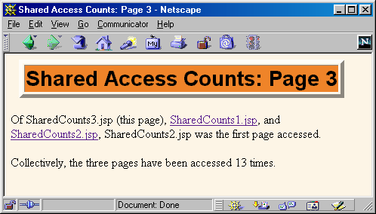
Accessing SharedCounts1, SharedCounts2, SharedCounts3
SharedCounts2.jsp was accessed first.
Pages have been accessed twelve previous times by an arbitrary number of clients

Slide 52
Summary
Benefits of jsp:useBean
  Hides the Java syntax
  Makes it easier to associate request parameters with Java objects (bean properties)
  Simplifies sharing objects among multiple requests or servlets/JSPs
jsp:useBean
  Creates or accesses a bean
jsp:getProperty
  Puts bean property (i.e. getXxx call) into servlet output
jsp:setProperty
  Sets bean property (i.e. passes value to setXxx)

Slide 53
Integrating Servlets and JSP: The MVC Architecture
Reasons to combine servlets and JSP
Approach to integration
Dispatching requests
Storing data for later retrieval
Example 1:
an on-line travel agent
Example 2:
an on-line boat store
Including requests:
showing raw servlet and JSP output

Slide 54
Uses of JSP Constructs
Simple
Application
Scripting elements calling servlet code directly
Scripting elements calling servlet code indirectly (by means of utility classes)
Beans
Custom tags
Servlet/JSP combo (MVC),
with beans and possibly custom tags
Complex
Application

Slide 55
Why Combine Servlets & JSP?
Typical picture: use JSP to make it easier to develop and maintain the HTML content
  For simple dynamic code, call servlet code from
  scripting elements
  For slightly more complex applications, use custom classes called from scripting elements
  For moderately complex applications,
  use beans and custom tags
But, that's not enough
  For complex processing, starting with JSP is awkward
  Despite the ease of separating the real code into separate classes, beans, and custom tags, the assumption behind JSP is that a single page gives a single basic look
Notes:
Scenarios of a purchasing website.

Slide 56
Possibilities for Handling a Single Request
Servlet only
  Output is a binary type. E.g.: an image
  No output. E.g.: you are doing forwarding or redirection as in Search Engine example.
  Format/layout of page is highly variable. E.g.: portal.
JSP only
  Output is mostly character data. E.g.: HTML
  Format/layout mostly fixed.
Combination
  A single request will result in multiple substantially different-looking results.
  Complicated data processing, but relatively fixed layout.
These apply to a single request
  You still use both servlets and JSP within your overall application.

Slide 57
Approach
Joint servlet/JSP process:
  Original request is answered by a servlet
  Servlet processes request data, does database lookup, business logic, etc.
  Results are placed in beans
  Request is forwarded to a JSP page to format result
  Different JSP pages can be used to handle different types of presentation
Often called the "MVC" (Model View Controller) or "Model 2" approach to JSP
Formalized in Apache Struts Framework
  http://jakarta.apache.org/struts/

Slide 58
Implementing MVC
The important thing is the idea
  Syntax not complicated
We already know
  How to extract previously-stored data in a JSP page
    Use jsp:useBean with the scope attribute
Two pieces of syntax we don't yet know
  How does a servlet invoke a JSP page?
  How does a servlet store data where it can be retrieved by
    jsp:useBean with scope="request"
    jsp:useBean with scope="session"
    jsp:useBean with scope="application"

Slide 59
Dispatching Requests from Servlets to JSP Pages
First, call the getRequestDispatcher method of ServletContext
  Supply URL relative to server or Web application root
  Example
    String url = "/presentations/presentation1.jsp";
    RequestDispatcher dispatcher =
    getServletContext().getRequestDispatcher(url);
Second
  Call forward to completely transfer control
  to destination page (no communication with client in between, as there is with response.sendRedirect)
    This is the normal approach with MVC
  Call include to insert output of destination page
  and then continue on

Slide 60
Forwarding Requests:
Example Code
public void doGet(HttpServletRequest request,
HttpServletResponse response)
throws ServletException, IOException {
String operation = request.getParameter(“submit");
if (operation == null) {
operation = "unknown";
}
if (operation.equals(“Add")) {
gotoPage("/operations/Add_Remove.jsp",
request, response);
} else if (operation.equals(“Remove")) {
gotoPage("/operations/Add_Remove.jsp",
request, response);
} else {
gotoPage("/operations/unknownRequestHandler.jsp",
request, response);
}
}

Slide 61
Forwarding Requests:
Example Code (Continued)
private void gotoPage(String address,
HttpServletRequest request,
HttpServletResponse response)
throws ServletException, IOException {
RequestDispatcher dispatcher =
getServletContext().getRequestDispatcher(address);
dispatcher.forward(request, response);
}

Slide 62
Reminder: JSP useBean
Scope Alternatives
request
  <jsp:useBean id="..." class="..." scope="request" />
session
  <jsp:useBean id="..." class="..." scope="session" />
application
  <jsp:useBean id="..." class="..." scope="application" />
page
  <jsp:useBean id="..." class="..." scope="page" />
  or just
  <jsp:useBean id="..." class="..." />
  This scope is not used in MVC (Model 2) architecture

Slide 63
Storing Data for Later Use:
The Servlet Request
Purpose
  Storing data that servlet looked up and that JSP page will use only in this request.
Servlet syntax to store data
  SomeClass value = new SomeClass(…);
  request.setAttribute("key", value);
  // Use RequestDispatcher to forward to JSP
JSP syntax to retrieve data
  <jsp:useBean
  id="key"
  class="somepackage.SomeClass"
  scope="request" />

Slide 64
Storing Data for Later Use:
The Servlet Request (Variation)
Purpose
  Storing data that servlet looked up and that JSP page will use only in this request.
Servlet syntax to store data
  Add new request parameters to servlet request
  String address ="/path/resource.jsp?newParam=value";
  RequestDispatcher dispatcher =
  getServletContext().getRequestDispatcher(address);
  dispatcher.forward(request, response);
JSP syntax to retrieve data
  No useBean syntax. However, recall that request parameters can be accessed without explicit Java code by means of jsp:setProperty.

Slide 65
Storing Data for Later Use:
The Session Object
Purpose
  Storing data that servlet looked up and that JSP page will use in this request and in later requests from same client.
Servlet syntax to store data
  SomeClass value = new SomeClass(…);
  HttpSession session =
  request.getSession(true);
  session.setAttribute("key", value);
  // Use RequestDispatcher to forward to JSP
JSP syntax to retrieve data
  <jsp:useBean
  id="key"
  class="somepackage.SomeClass"
  scope="session" />

Slide 66
Variation for Session Tracking
Use response.sendRedirect instead of RequestDispatcher.forward
Distinctions: with sendRedirect:
  User sees JSP URL (user sees only servlet URL with RequestDispatcher.forward)
  Two round trips to client (only one with forward)
Advantage of sendRedirect
  User can visit JSP page separately
    User can bookmark JSP page
Disadvantage of sendRedirect
  Since user can visit JSP page without going through servlet first, JSP data might not be available
    So, JSP page needs code to detect this situation

Slide 67
Storing Data for Later Use:
The Servlet Context
Purpose
  Storing data that servlet looked up and that JSP page will use in this request and in later requests from any client.
Servlet syntax to store data
  synchronized(this) {
  SomeClass value = new SomeClass(…);
  getServletContext().setAttribute("key",
  value);
  // RequestDispatcher forwards to JSP
  }
JSP syntax to retrieve data
  <jsp:useBean
  id="key"
  class="somepackage.SomeClass"
  scope="application" />

Slide 68
Relative URLs in JSP Pages
Issue:
  Forwarding with a request dispatcher is transparent to the client. Original URL is only URL browser knows about.
Why does this matter?
  What will browser do with tags like the following:
  <IMG SRC="foo.gif" …>
  <LINK REL=STYLESHEET
  HREF="JSP-Styles.css"
  TYPE="text/css">
  <A HREF="bar.jsp">…</A>
  Answer: browser treats them as relative to servlet URL
Simplest solution:
  Use URLs that begin with a slash

Slide 69
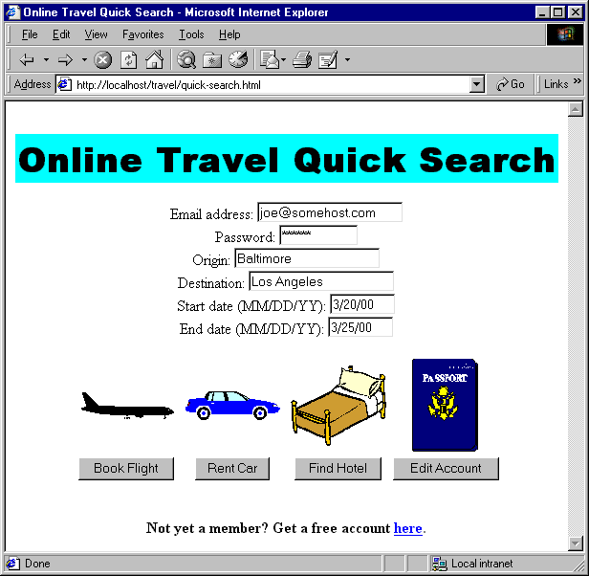
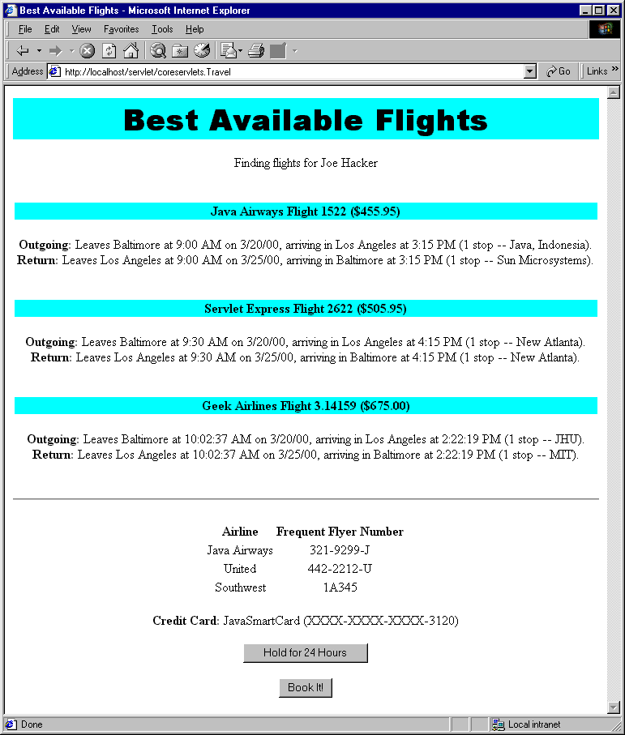
MVC Example 1:
An On-Line Travel Agent

Slide 70
MVC Example 1:
An On-Line Travel Agent
All requests include
  Email address, password, trip origin, trip destination, start date, and end date
Original request answered by servlet
  Looks up real name, address, credit card information, frequent flyer data, etc., using email address and password as key. Data stored in session object.
Depending on what button user pressed, request forwarded to:
  Page showing available flights, times, and costs
  Page showing available hotels, features, and costs
  Rental car info, edit customer data, error handler

Slide 71
An On-Line Travel Agent:
Servlet Code
public void doPost(HttpServletRequest request,
HttpServletResponse response)
...// Store data in TravelCustomer bean called "customer"
HttpSession session = request.getSession(true);
session.setAttribute("customer", customer);
if (request.getParameter("flights") != null) {
gotoPage("/travel/BookFlights.jsp",
request, response);
} else if ...
}
private void gotoPage(String address,
HttpServletRequest request,
HttpServletResponse response)
throws ServletException, IOException {
RequestDispatcher dispatcher =
getServletContext().getRequestDispatcher(address);
dispatcher.forward(request, response);
}

Slide 72
An On-Line Travel Agent:
JSP Code (Flight Page)
<BODY>
<H1>Best Available Flights</H1>
<CENTER>
<jsp:useBean id="customer"
class="coreservlets.TravelCustomer"
scope="session" />
Finding flights for
<jsp:getProperty name="customer"
property="fullName" />
<P>
<jsp:getProperty name="customer" property="flights" />
...

Slide 73
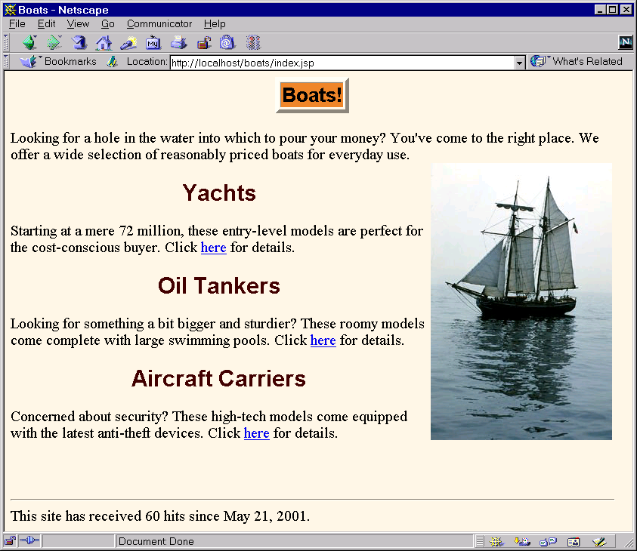
MVC Example 2:
An Online Boat Store

Slide 74
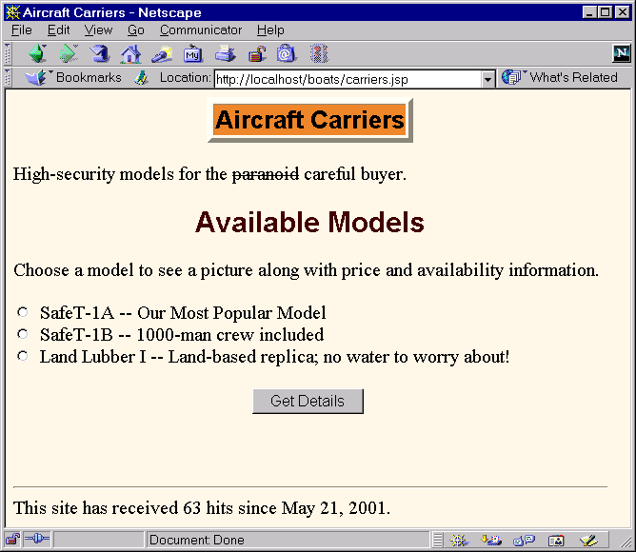
MVC Example 2:
An Online Boat Store

Slide 75
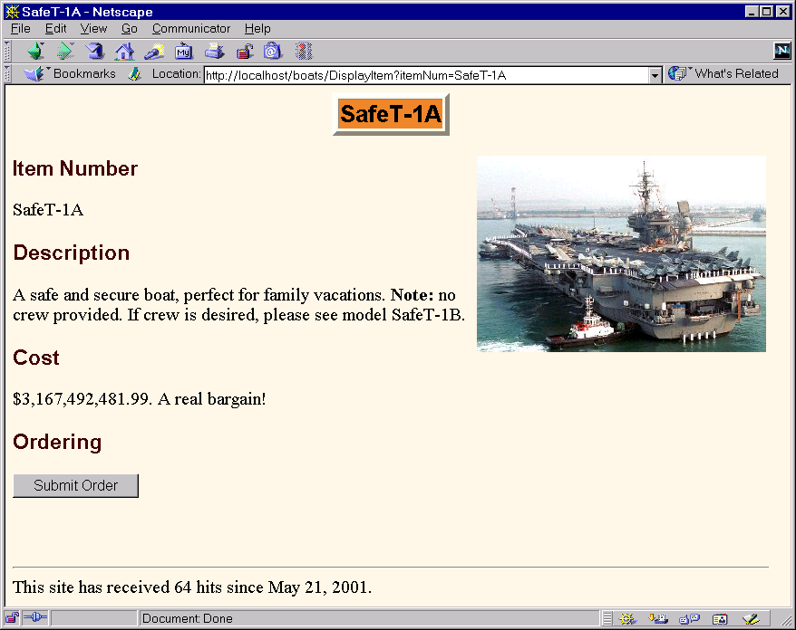
MVC Example 2:
An Online Boat Store

Slide 76
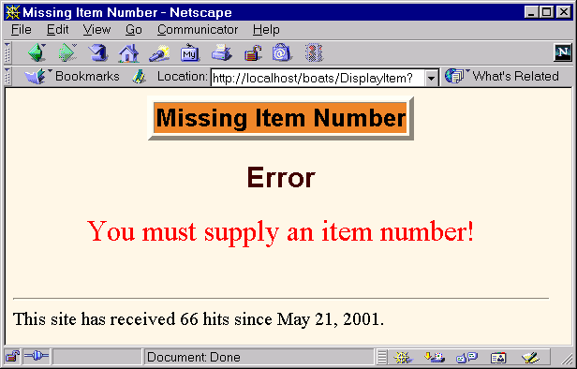
MVC Example 2:
An Online Boat Store

Slide 77
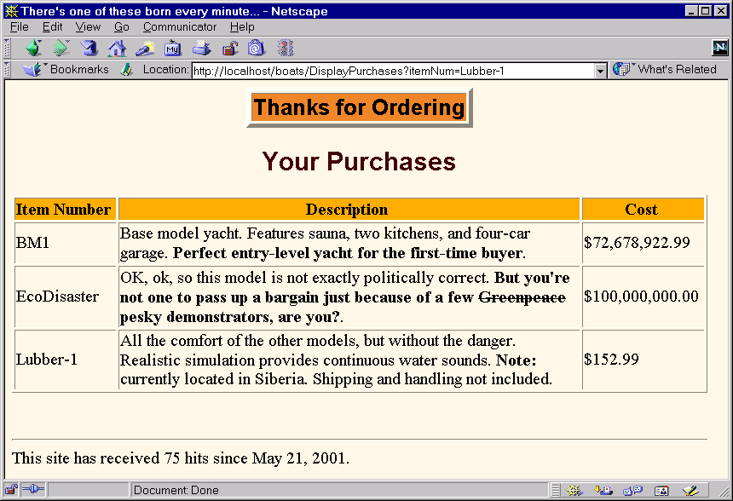
MVC Example 2:
An Online Boat Store

Slide 78
MVC Example 2:
Servlet Code
public class ShowItem extends HttpServlet {
public void doGet(HttpServletRequest request,
HttpServletResponse response)
throws ServletException, IOException {
String itemNum = request.getParameter("itemNum");
String destination;
if (itemNum == null) {
destination = "/MissingItem.jsp";
} else {
destination = "/ShowItem.jsp";
ItemTable shipTable = ShipTable.getShipTable();
SimpleItem item = shipTable.getItem(itemNum);
request.setAttribute("item", item);
}
RequestDispatcher dispatcher =
getServletContext().getRequestDispatcher(destination);
dispatcher.forward(request, response);
}
}

Slide 79
MVC Example 2:
An Online Boat Store
Hidden
Field

Slide 80
MVC Example 2:
JSP Code (ShowItem.jsp)
<!DOCTYPE HTML PUBLIC "-//W3C//DTD HTML 4.0 Transitional//EN">
…
<jsp:useBean id="item"
class="moreservlets.SimpleItem"
scope="request" />
<TITLE><jsp:getProperty name="item" property="itemNum" />
</TITLE>
…
<TABLE BORDER=5 ALIGN="CENTER">
<TR><TH CLASS="TITLE">
<jsp:getProperty name="item" property="itemNum" /></TABLE>
<P>
<IMG SRC="<jsp:getProperty name='item' property='imageURL' />"
ALIGN="RIGHT">
<H3>Item Number</H2>
<jsp:getProperty name="item" property="itemNum" />
<H3>Description</H2>
<jsp:getProperty name="item" property="description" />

Slide 81
MVC Example 2:
JSP Code (ShowItem.jsp Cont.)
<H3>Cost</H2>
<jsp:getProperty name="item" property="costString" />.
A real bargain!
<H3>Ordering</H2>
<FORM ACTION="DisplayPurchases">
<INPUT TYPE="HIDDEN" NAME="itemNum"
VALUE="<jsp:getProperty name='item'
property='itemNum' />">
<INPUT TYPE="SUBMIT" VALUE="Submit Order">
</FORM>
<%@ taglib uri="/WEB-INF/tlds/count-taglib.tld"
prefix="boats" %>
<boats:count />
</BODY>
</HTML>

Slide 82
MVC Example 2:
Bean Code (SimpleItem.java)
public class SimpleItem {
private String itemNum = "Missing item number";
private String description = "Missing description";
private String imageURL = "Missing image URL";
private double cost;
private NumberFormat formatter =
NumberFormat.getCurrencyInstance();
public SimpleItem(String itemNum,
String description,
String imageURL,
double cost) {
setItemNum(itemNum);
setDescription(description);
setImageURL(imageURL);
setCost(cost);
}
public SimpleItem() {}
…
}

Slide 83
Forwarding Requests from JSP Pages -- jsp:forward
You usually forward from a servlet to a JSP page, but you can also forward from JSP
<% String destination;
if (Math.random() > 0.5) {
destination = "/examples/page1.jsp";
} else {
destination = "/examples/page2.jsp";
}
%>
<jsp:forward page="<%= destination %>" />
Question: can you forward from a servlet to another servlet? How do you know?

Slide 84
Including Pages Instead of Forwarding to Them
With the forward method of RequestDispatcher:
  Control is permanently transferred to new page
  Original page cannot generate any output
With the include method of RequestDispatcher:
  Control is temporarily transferred to new page
  Original page can generate output before and after the included page
  Original servlet does not see the output of the included page (for this, see later topic on servlet/JSP filters)
  Useful for portals: JSP presents pieces, but pieces arranged in different orders for different users

Slide 85
A Servlet that Shows Raw Servlet and JSP Output
out.println(...
"<TEXTAREA ROWS=30 COLS=70>");
if ((url == null) || (url.length() == 0)) {
out.println("No URL specified.");
} else {
// Attaching data works only in version 2.2.
String data = request.getParameter("data");
if ((data != null) && (data.length() > 0)) {
url = url + "?" + data;
}
RequestDispatcher dispatcher =
getServletContext().getRequestDispatcher(url);
dispatcher.include(request, response);
}
out.println("</TEXTAREA>\n" +
...);

Slide 86
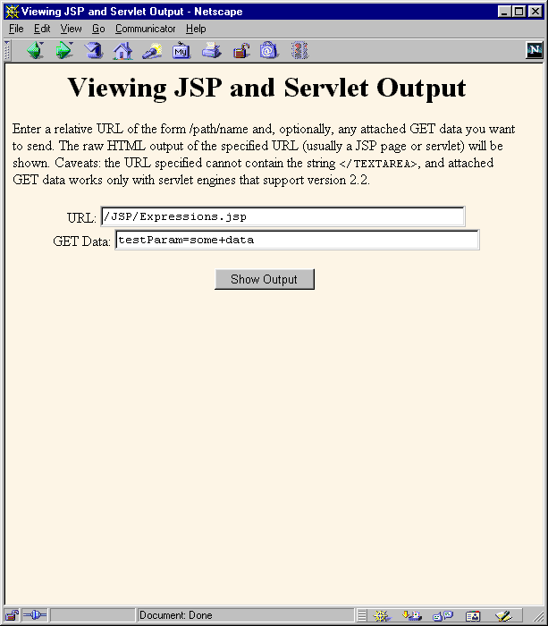
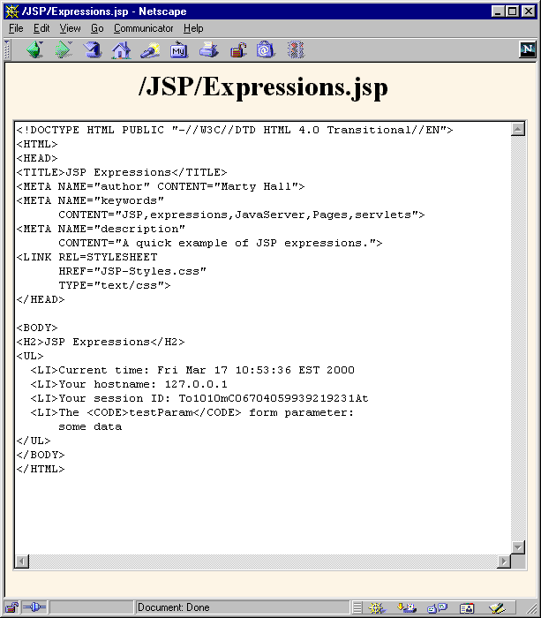
A Servlet that Shows Raw Servlet and JSP Output

Slide 87
Summary
Use MVC (Model 2) approach when:
  One submission will result in more than one basic look
  Several pages have substantial common processing
Architecture
  A servlet answers the original request
  Servlet does the real processing & stores results in beans
    Beans stored in HttpServletRequest, HttpSession, or ServletContext
  Servlet forwards to JSP page via forward method of RequestDispatcher
  JSP page reads data from beans by means of jsp:useBean with appropriate scope (request, session, or application)

